Slide 1
البصمة الوراثية
د. علي جعفر سليم

Slide 2
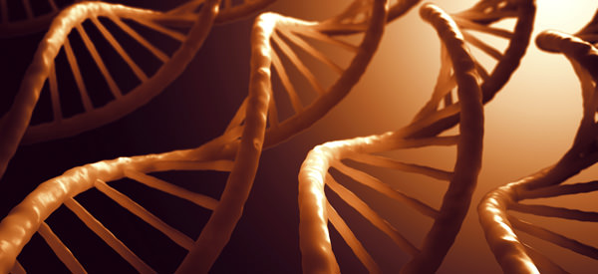
DNA Fingerprinting

Slide 3
INTRODUCTION:
DNA Fingerprinting & DNA Profiling - same or different?
The process of DNA fingerprinting was developed by Professor Alec Jeffreys at Leicester University in 1984 as a form of genetic analysis.
It was first used in the law courts of England in 1987 to convict a man in a rape case.
It has now been used successfully in many crime and paternity cases in worldwide.

Slide 4
Although 99.9% of human DNA sequences are the same in every person, enough of the DNA is different to distinguish one individual from another, unless they are monozygotic twins.
DNA profiling uses repetitive sequences that are highly variable, called variable number tandem repeats (VNTRs), particularly short tandem repeats (STRs). VNTR loci are very similar between closely related humans.
The analysis of variable number of tandem repeats (VNTRs), to detect the degree of relatedness to another sequence of oligonucleotides , making them ideal for DNA fingerprinting.

Slide 5
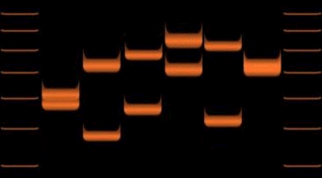
Variable Number Tandem Repeat
A Variable Number Tandem Repeat (or VNTR) is a location in a genome where a short nucleotide sequence is organized as a tandem repeat.
These can be found on many chromosomes, and often show variations in length between individuals.
Each variant acts as an inherited allele, allowing them to be used for personal or parental identification.

Slide 6
Short Tandem Repeats
DNA profiling depends on regions of non-coding DNA that show great variability between individuals (are polymorphic which means many forms)
Modern profiling uses Short Tandem Repeats, STRs
These are short sequences of DNA, usually 2-5 base pairs (bp) long, that repeat, or ‘stutter’ many times

Slide 7
Stages of DNA Profiling
Stage 1:
Cells are broken down
to release DNA
If only a small amount of DNA is available it can be amplified using the polymerase chain reaction (PCR)

Slide 8
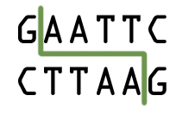
Stages of DNA Profiling
Step 2:
The DNA is cut into fragments using restriction enzymes.
Each restriction enzyme cuts DNA at a specific base sequence.

Slide 9
Stages of DNA Profiling
The sections of DNA that are cut out are called restriction fragments.
This yields thousands of restriction fragments of all different sizes because the base sequences being cut may be far apart (long fragment) or close together (short fragment).

Slide 10
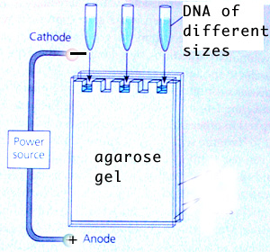
Stages of DNA Profiling
Stage 3:
Fragments are separated on the basis of size using a process called gel electrophoresis.
DNA fragments are injected into wells and an electric current is applied along the gel.

Slide 11
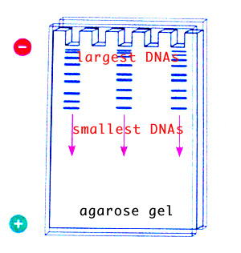
Stages of DNA Profiling
DNA is negatively charged so it is attracted to the positive end of the gel.
The shorter DNA fragments move faster than the longer fragments.
DNA is separated on basis of size.

Slide 12
Stages of DNA Profiling
A radioactive material is added which combines with the DNA fragments to produce a fluorescent image.
A photographic copy of the DNA bands is obtained.

Slide 13
Stages of DNA Profiling
Stage 4:
The pattern of fragment distribution is then analysed.

Slide 14
Some uses of DNA Profiling
Forensic work on crime scenes
Parentage testing
Victim identification in mass disasters
Animal identification
Conservation biology and evolutionary studies
Migration

Slide 15
Biological materials used for DNA profiling
The DNA profile of each individual is highly specific.
The chances of two people having exactly the same DNA profile is 30,000 million to 1 (except for identical twins).
Blood
Hair
Saliva
Semen
Body tissue cells

Slide 17
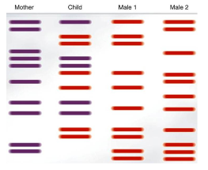
Paternity Test

Slide 18
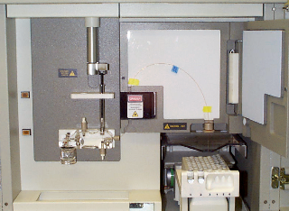
Genetic Analyzer

Slide 19
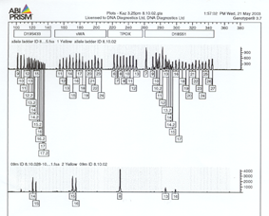
Analyzing the Read-out
Digital output from the Analyzer is read and interpreted by genotyping software
Each STR region read has two peaks, for the regions (loci) on an individual’s maternal and paternal chromosomes with that locus. note - if both regions are the same length, there is one peak
Data is shown both graphically and numerically

Slide 20
Thanks
for giving me little attention.

